Slide 1
Article III: The judicial Branch
The judiciary is simply the judicial branch of government, which includes the court system and the judges. Lady Justice is present outside of our nation’s courtrooms. She symbolizes fair and equal administration of the law, without corruption, favor, greed, or prejudice.
Essential Question: Does our nation’s court system effectively meet the standards set forth by Lady Justice?

Slide 2
Judiciary Branch Vocabulary Terms & Phrases Available on Quizlet
Supreme Court
Justice
Chief Justice
Associate Justice
Judge
Plaintiff
Prosecutor
Defendant
Criminal Case
Civil Case
Original Jurisdiction
Appellate Jurisdiction
Federal Court
State Court
District Court
Courts of Appeal
Certiorari
Rule of Four
Recess
Conference
Quorum
Majority Opinion
Concurring Opinion
Dissenting Opinion
Precedent
Judicial Activism
Judicial Restraint
Balance of probability
Beyond reasonable doubt
Innocent until proven guilty
Appeal
Acquit
Unanimous

Slide 3
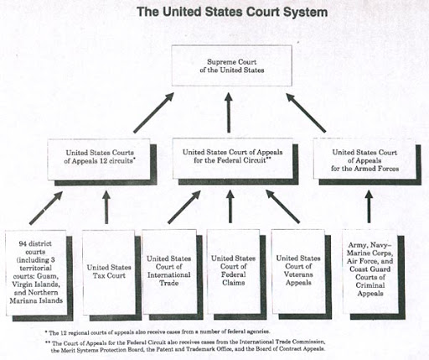
Overview of the Judicial Branch
The U.S. Constitution is the supreme law of the land in the United States. It creates a federal system of government in which power is shared between the federal government and the state governments. Due to federalism, both the federal government and each of the state governments have their own court systems.
The judicial branch must apply the existing laws to each individual situation, to be sure justice is administered fairly. This includes punishing those who are guilty of breaking the law, and keeping the rest of the community safe from crime. (Criminal Courts)
Courts also settle disputes between citizens that they can’t resolve on their own. (Civil Courts)
Taxes, International Trade, Veteran Affairs cases are addressed in Federal Courts. The military handles their own cases, but ultimately can be appealed to the Supreme Court.

Slide 4
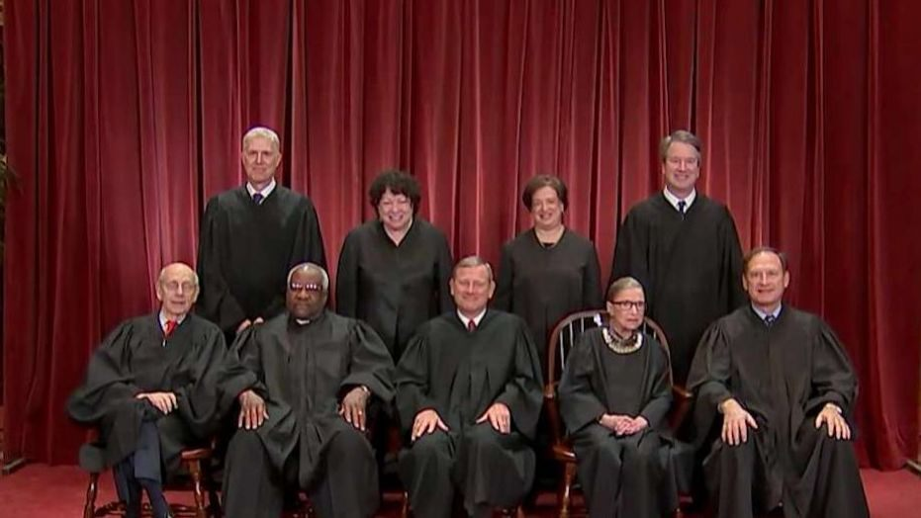
The Supreme Court
The Supreme Court is the highest federal court in the United States and was established in the Constitution in Article III. The Supreme Court is known as the court of last resort. A decision issued by the Supreme Court cannot be appealed.
The Supreme Court has both original and appellate jurisdiction. The court has original jurisdiction in cases of suits between states or cases involving ambassadors or public ministers. It has appellate jurisdiction on almost any other case on appeal that involves a point of constitutional and/or federal law.
There are nine Justices on the Supreme Court; there are eight associate justices and one chief justice. The Constitution requires a president to nominate a justice and the Senate to confirm the appointment. Once confirmed, the Justice has a lifetime position on the bench.
Justices in back from left to right: Gorsuch, Sotomayor, Kagan, and Kavanaugh. Justices in front from left to right: Breyer, Thomas, Chief Justice Roberts, Ginsburg, and Alito.

Slide 5
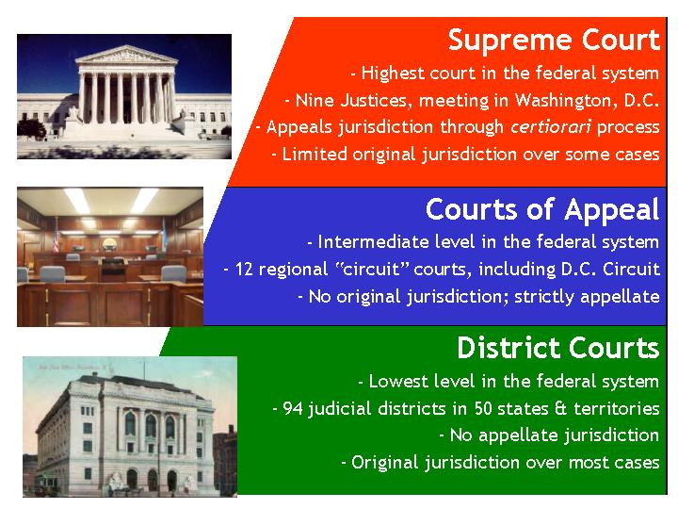
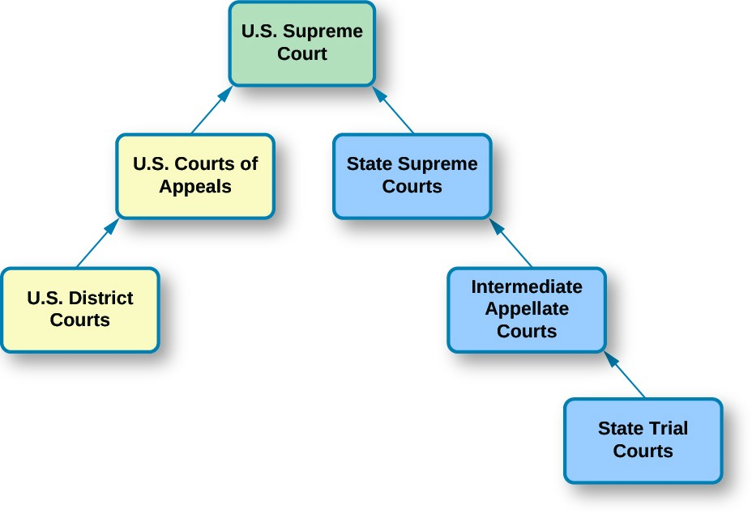
Court System Levels:
Federal courts have limited jurisdiction and may only hear cases authorized by the U.S. Constitution or federal statutes. The federal courts have three levels: district courts (the trial courts), circuit courts (first level of appeals), and the Supreme Court.
State courts are courts of general jurisdiction, meaning that they hear cases that not specifically selected for federal courts. State courts interpret state laws.

Slide 6
Procedures & Functions of The Supreme Court
The Supreme Court typically receives around 7,000 requests each year. On average, they choose to hear arguments on 80 cases and decide another 50 cases without hearing arguments. The cases chosen by the Supreme Court usually address issues of constitutionality or federal law.
Some cases reach the Supreme Court through a writ of certiorari. The ‘rule of four’ states that at least four of the nine justices must agree to hear a case in order for that case to be placed on the court’s docket, or calendar. If they agree to hear a given case, the petition for certiorari is granted.
Once the Supreme Court accepts a case, it sets a date on which the case will be held. The justices consider cases on two-week cycles. They hear oral arguments for two weeks and then recess for two weeks to consider those cases and handle other court business. When the justices meet to decide cases, they are said to be in conference. The Chief Justice speaks first, and then each associate justice summarizes his or her views. After discussion and debate, the justices vote on the case. A quorum of six justices is required to hear a case, and decisions are based on majority votes.
The court’s decision on a case is known as the majority opinion, or the opinion of the court and announces the court’s decision in a case. The opinion sets out the reasoning for the decision. If the Chief Justice is in the majority on a case, he assigns the writing of the court’s opinion. The majority opinions serve as precedents for future cases. Sometimes justices may decide to write concurring opinions. This is when one or more of the justices agree with the court’s opinion and want to add or emphasize points not made in the majority opinion. Dissenting opinions are written by those justices who do not agree with the court’s majority decision. This is also known as the minority opinion

Slide 7
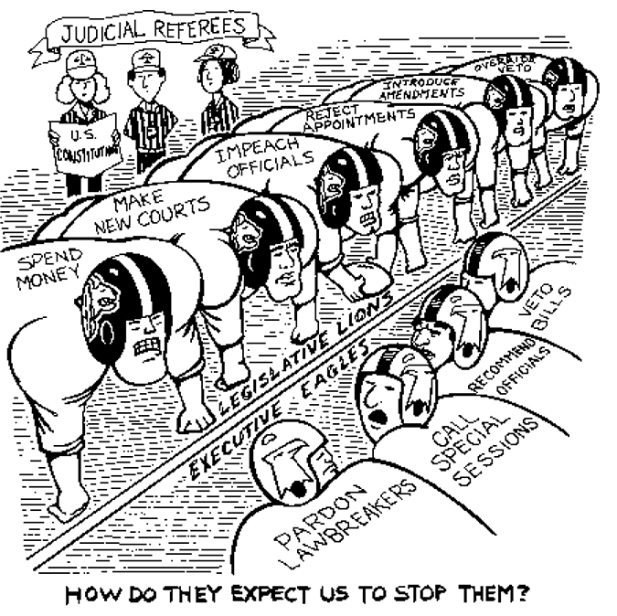
Judicial Restraint vs. Judicial Activism
This political cartoon summarizes the checks and balances between the branches of government. We want our Judicial Branch to be apolitical (not involved in politics), and focused entirely on the interpretation of the laws that govern our nation. This highlights the struggle that exists in our current court system.
Strict Constructionist: Judges are bound by wording of the Constitution = Judicial Restraint
Activist/Loose Constructionist: Judges should look to underlying principles of Constitution = Judicial Activism
***A judge can be both conservative and activist, or liberal and strict constructionist. However, society associates activists with liberals, and strict constructionists with conservatives.

Slide 8
Judicial Activism
Philosophy and Goals
The courts should take an active role in solving society’s problems and upholding minority rights.
Courts should uphold the “guardian ethic:” They act as a guardian of the people.
Examples include Civil War Era, Progressive Era, and Civil Rights Era court cases. These eras addressed unlawful procedures enforced by precedent, but the Supreme Court overruled these policies and attempted to establish a fairer system moving forward.
Cons
This process usurps power of the legislature, thereby diminishing the rule of law and democracy.
Crafting decisions to solve immediate problems may create reasoning and precedent that is problematic when applied to future policies.
Judicial Restraint
Philosophy and Goals
The courts should allow the states and the other two branches of the federal government to solve social, economic, and political problems.
Federal courts should act only when there are clear constitutional questions. Courts should defer to elected lawmakers.
The Courts should merely interpret the law rather than make law. The original intent of Founders should be the main objective.
Cons
This viewpoint does not adequately address injustice or the need for social change.
It does not provide a method to actively interpret the Constitution as new conditions arise.

Slide 9
Civil Courts
Civil cases do not involve a crime. It begins when a plaintiff brings the case against another body (defendant) who has failed to carry out a legal duty. Civil cases usually involve a contract dispute between private individuals or corporations seeking to collect money owed or monetary damages. Civil cases also include divorce or issues related to child custody.
The majority of civil cases do not involve a jury. Laws vary by state and county, but a jury’s verdict may not have to be unanimous. Judges ensure law prevails over passion during a civil case. Defendants can be found liable or not liable for damages. The punishment is often a fine, or simply stopping the offending act. A plaintiff must produce evidence beyond the balance of probabilities.
Criminal Courts
Criminal cases are brought by a local, state, or federal government and involve violation of a law. These cases include theft, assault, robbery, trafficking in controlled substances, murder, etc. The government must prove, beyond a reasonable doubt, the defendant broke the law.
In a criminal case, the victim does not bring the case against the defendant. The state or federal government serves as the prosecutor. The prosecutor seeks jail time, fines, or both for a defendant. The government must present evidence as the defendant is innocent until proven guilty.
The jury must agree unanimously prior to conviction. A defendant is acquitted if not guilty. Only the defendant may appeal a court's verdict. The prosecution is not allowed to appeal.

Slide 10
Final Message
These notes were designed to improve a student’s understanding of our nation’s legal system. The materials assembled and presented on the teacher website supplement these notes and encourage discussion and debate activities in the classroom. Please review the following materials on the teacher website at www.nickaugustine.org and access the civics tab to gain a greater understanding of the Judicial Branch.
Time Magazine SCOTUS Cases Link
Do I Have A Right iCivics Game (Complete amendment review)
Argument Wars iCivics Game
Know Your Rights, “Don’t Talk To The Police” Law Professor Video Lecture
60 Minutes False Confessions Video

